Slide 1

Analysing Smart Device Usage Trends to Provide Insights for Bellabeat
May 2024
David Mudiwa

Slide 2
Table of Contents
Purpose Statement (What we are talking about?)
Telling the story with data
Conclusion
Recommendations

Slide 3
Business Task
What are some trends in smart device usage?
How could these trends apply to Bellabeat customers?
How could these trends help influence Bellabeat marketing strategy?

Slide 4
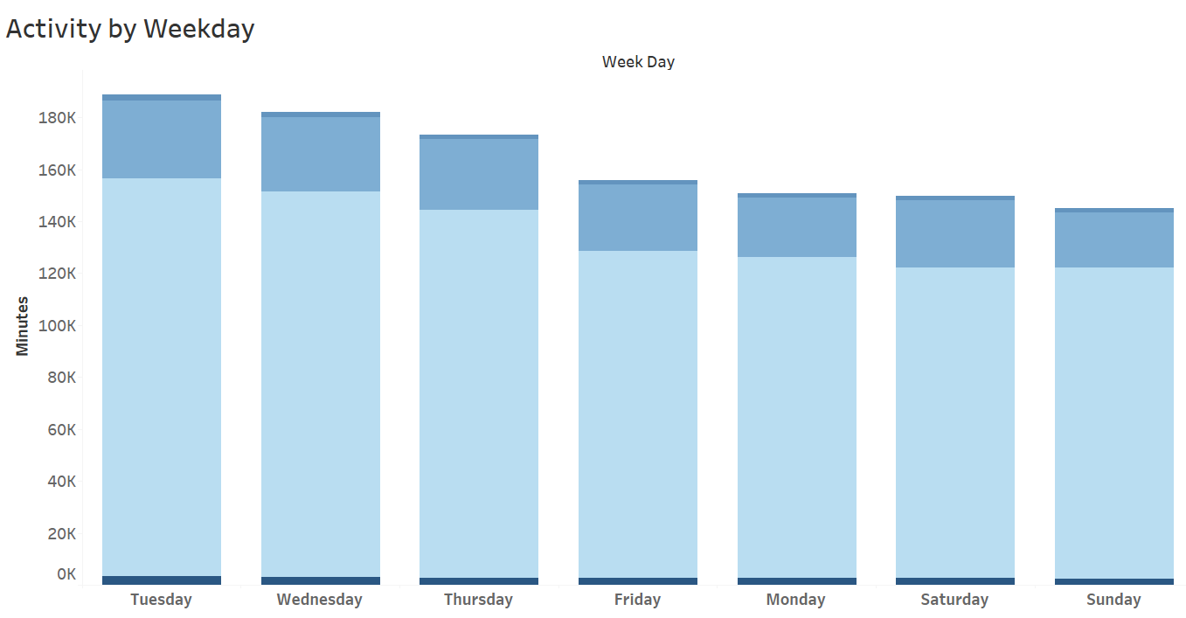
Activity Levels During Weekdays
Tuesday is when most users are active
Most users spend a lot of time sedentary which could be of concern for health and wellness

Slide 5
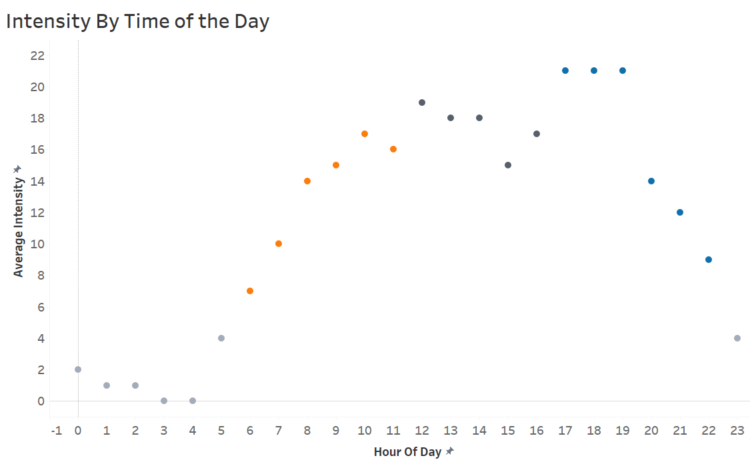
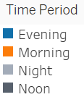
Intensity Levels during the Day
Peak intensity levels are from 1800 to 2000hrs in the evening
Generally, high intensity levels are experienced from 0800hrs in the morning to 2100hrs in the evening

Slide 6
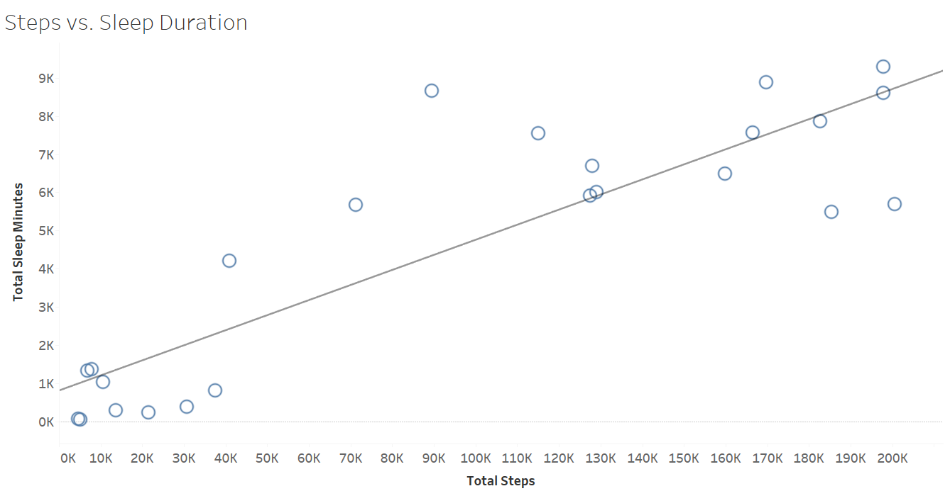
Relationship Between Walking distance and sleep
Strong correlation between distance walked and sleep duration
Most users spend a lot of time sedentary which could be of concern for health and wellness
What contributes to longer sleep duration?
r=0.8

Slide 7
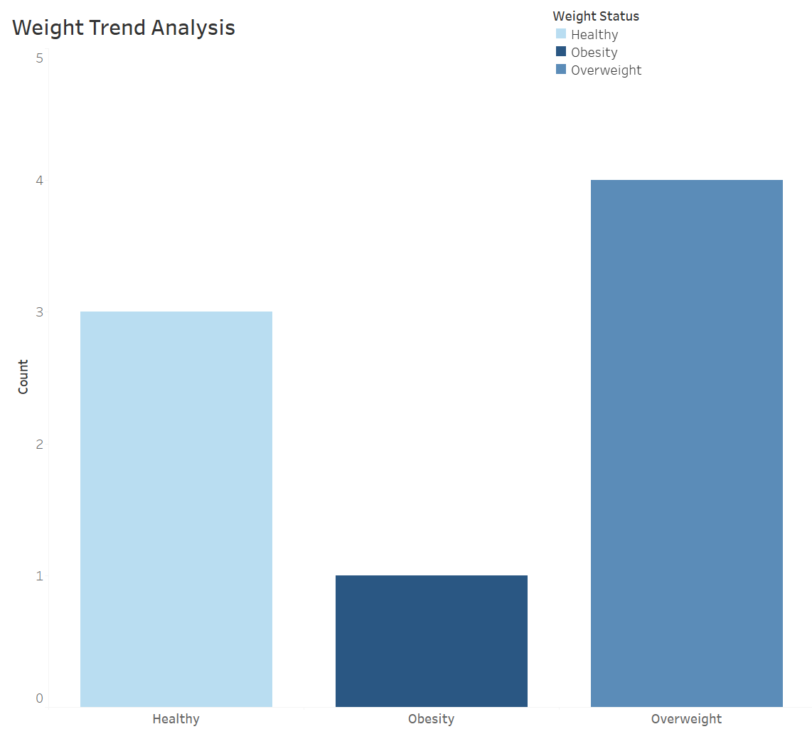
Weight Trend Analysis
Out of the users who utilize weight tracking feature on their devices, 4 are overweight, 1 is obese and 3 fall in the healthy range
Is the weight tracking feature mostly used by individuals who are trying to reduce their weight because they are not healthy?

Slide 8
Conclusion
Q. What are some trends in smart device usage?
1
2
3
Correlation Between Steps and Sleep Minutes: Women who walk long distances tend to have longer sleep durations.
Activity levels and Sedentary Behavior: Most of the women are more likely to be engaged in physical activities on Tuesday .
Sedentary behavior is common among women, which can be a threat to wellness and health.
Intensity Levels: High intensity levels occur primarily from 8am to 9pm in the evening.

Slide 9
Recommendations
How could these trends apply to Bellabeat customers?
Bellabeat could use the positive correlation between steps and sleep to encourage users to be more active, in order to improve their sleep quality through personalized recommendations.
Bellabeat can design features to reduce sedentary time and promote an active lifestyle including activity reminders and guided exercise sessions.
2. How could these trends help influence Bellabeat marketing strategy?
They could highlight how important physical activity is for getting better sleep, hence the need for it’s products as vital tools for health management.
Marketing messages and adverts could be timed during peak activity hours(8am to 8pm) for more visibility and engagement

Slide 10
THANK YOU!

